Slide 1
Lecture 10
x86-64 Stacks

Slide 2
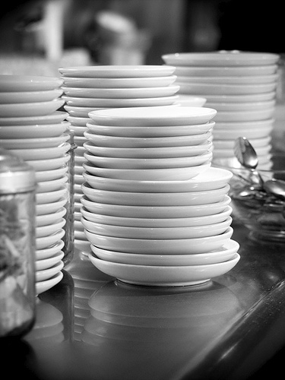

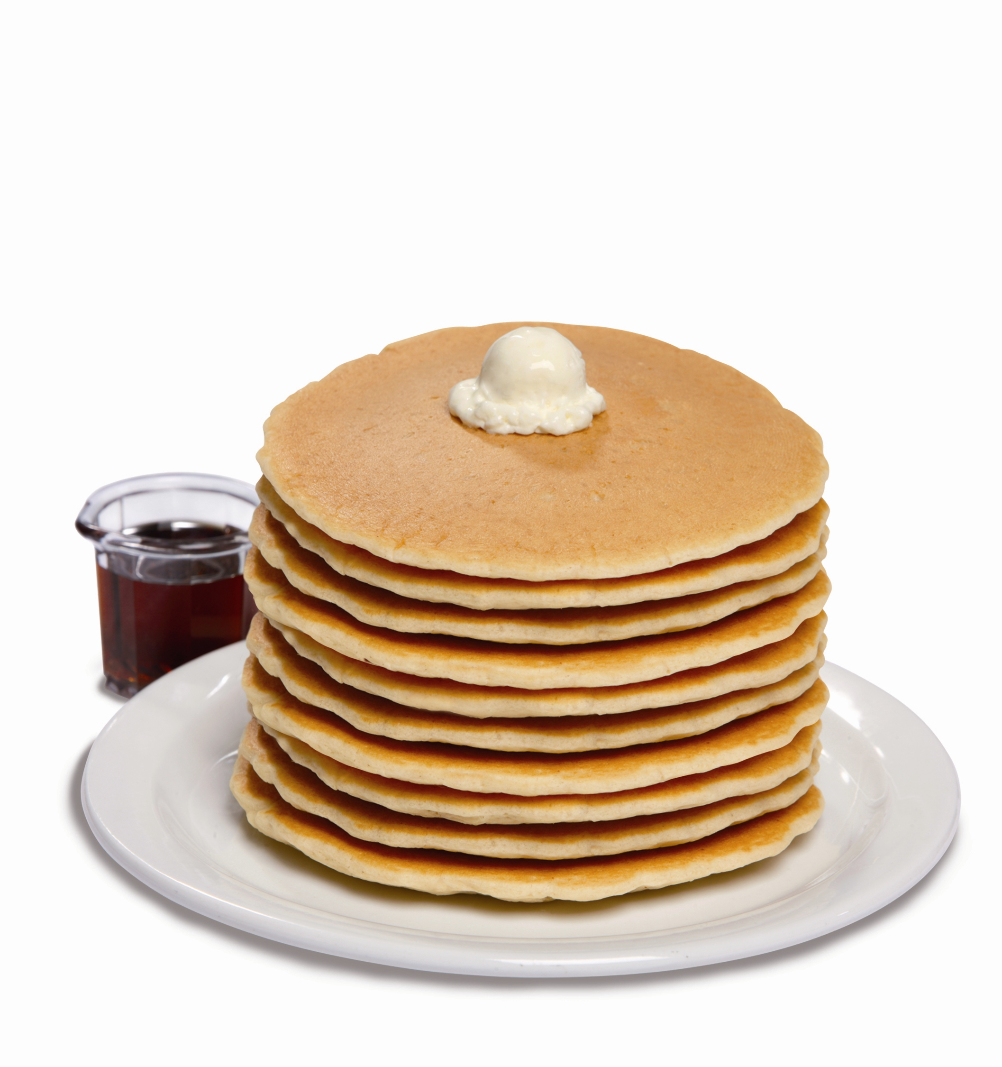

The Stack
Definition: A stack is a last-in-first-out (LIFO) data structure, essentially with two operations:
push(arg)
pop(&arg)
- put arg at the top of the stack
- remove topmost element of the stack and place in arg
a stack of plates
a stack of books
a stack of pancakes

Slide 3
x86-64 Stack Operations
Stacks are so commonly employed in algorithms, that CPUs have their own stacking operations. In x86-64:
SP
maintains
initialized to some value at startup
stack grows
pushq src
push quad word
popq dest
pop quad word
≡ stack pointer
(%rsp)
address of last used byte of the stack
M[]
≡ the top
towards low memory
initial
SP
rsp ← rsp − 8
M[rsp] ← src
grows
SP during
execution
dest ← M[rsp]
rsp ← rsp + 8
addr

Slide 4
Stack Application 1: Spilling
%rdi - long *x
%rsi - long *y
%rax - return value
Sometimes there aren’t enough registers to hold your computation.
E.g., Dot product
perform x[0]*y[0] + x[1]*y[1]
vars:
use the stack for temporary storage
dot: movq (%rdi), %rax
imul (%rsi), %rax
Still need to do x[1]*y[1] before adding, but while remembering x[0]*y[0]
x[0]*y[0]
pushq %rax
spill partial computation
need another scratch register
if all scratch registers in use, then spill to stack
movq 8(%rdi), %rax
imul 8(%rsi), %rax
x[1]*y[1]
addq (%rsp), %rax
leaq 8(%rsp), %rsp
pop
Notes:
A demo with gdb: break on dot, step through code, show stack ptr, x $rsp vs print $rsp

Slide 5
Spilling: Alternate Solution
E.g., Dot product
perform x[0]*y[0] + x[1]*y[1]
Alternate solution:
free up a scratch register
push its value on the stack, and restore later
dot: movq (%rdi), %rax
imul (%rsi), %rax
x[0]*y[0]
pushq %rbx
save rbx (in use)
movq 8(%rdi), %rbx
imul 8(%rsi), %rbx
x[1]*y[1]
addq %rbx, %rax
popq %rbx
restore rbx’s value
Notes:
A demo with gdb: break on dot, step through code, show stack ptr, x $rsp vs print $rsp

Slide 6
Stack Application 2: Function Calls
Kleene star
A function may call a function (which may a call function)*
when a function completes, resume with
the most recently called function
LIFO order
Stack space is used to temporarily hold some/all of:
parameters (but often held in registers)
7th parameter and beyond
return address
local variables & caller’s registers
One stack frame per function call
Next time: function call protocol
Notes:
Oral note: return value passed in rax

